Slide 1
Hierarchical Softmax
Nan Jiang

Slide 2
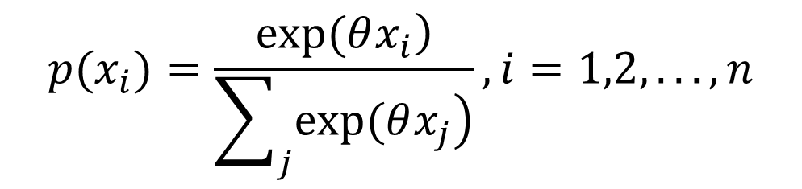
Normal Softmax
If hidden_size=500 and output_vocabulary=2000, this process is time comsuming.
$$p(x_{i})=\frac{\left.exp(θx_{i}\right)}{\sum_{j}{\left.exp(θx_{j}\right)}},i=1,2,...,n$$

Slide 3
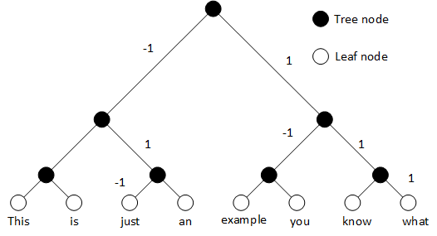
Hierarchical Softmax
Transform multi-label prediction into binary logistic prediction

Slide 4
Vocabulary encoding
“just” : [0,0,….1,0,0,….0], index =2
“know”: [0,0,….1,0,0,….0], index=6
Tree encoding
“just” : [-1 1 -1]
“know”: [1 1 -1]

Slide 5
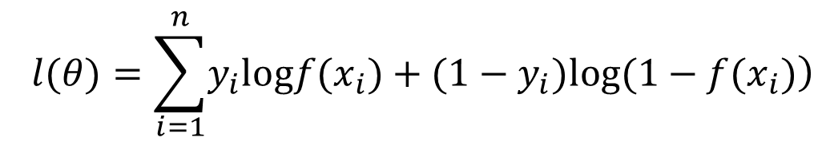
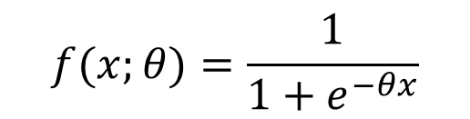


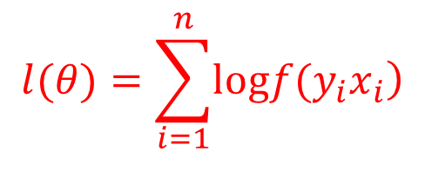
Modify Logistic classification
$$f(x;θ)=\frac{1}{1+e^{−θx}}$$
$$\begin{matrix}l(θ)=\sum_{i=1}^{n}{\left.y_{i}logf(x_{i})+(1−y_{i})log(1−f(x_{i})\right)} \\ \end{matrix}$$
$$y∈[0,1]$$
$$\begin{matrix}l(θ)=\sum_{i=1}^{n}{\left.logf(y_{i}x_{i}\right)} \\ \end{matrix}$$
$$y∈[−1,1]$$

Slide 6
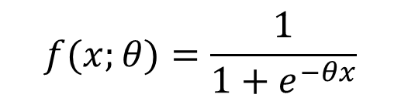
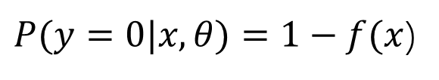

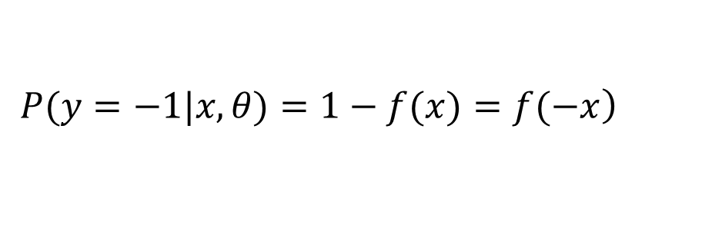

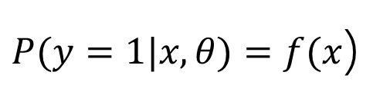
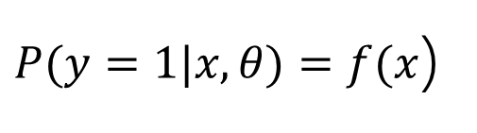

Why ?
$$f(x;θ)=\frac{1}{1+e^{−θx}}$$
$$\left.y∈[0,1\right]$$
$P(y=1|x,θ)=f(x$)
$$f(x)+f(−x)=1$$
$P(y=0|x,θ)=1−f(x$)
$$\left.y∈[−1,1\right]$$
$P(y=1|x,θ)=f(x$)
$$\left.P(y=−1|x,θ)=1−f(x)=f(−x\right)$$

Slide 7
Building Binary Tree
From bottom to root.
Union two node as a new node.

Slide 8
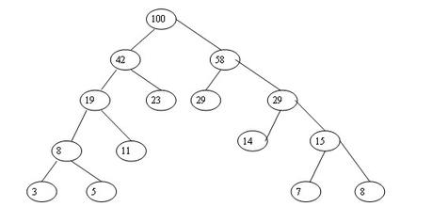
Huffman tree is not optimal
The overall process is related to the maximum
“tree encoding”length.
Huffman tree would cause more memory as un-equal encoding.
So a simple binary balanced tree would work much better.

Slide 9
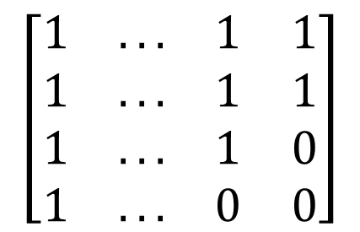
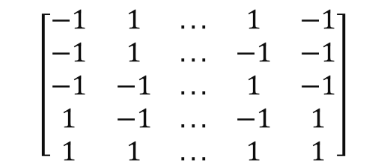
Route matrix
V x log|V|
$$\left[\begin{matrix}−1 & 1 & ... & 1 & −1 \\ −1 & 1 & ... & −1 & −1 \\ −1 & −1 & ... & 1 & −1 \\ 1 & −1 & ... & −1 & 1 \\ 1 & 1 & ... & 1 & 1\end{matrix}\right]$$
Mask matrix
V x log|V|
$$\left[\begin{matrix}1 & ... & 1 & 1 \\ 1 & ... & 1 & 1 \\ 1 & ... & 1 & 0 \\ 1 & ... & 0 & 0\end{matrix}\right]$$

Slide 10
Classification procedure
Calculate the sigmoid result
Calculate the masked result
Summarize the results
X,y → final
1. z=sigmoid( y(i)* X )
2. results=log(z)* masks[y(i)]
3. final=sum(results)

Slide 11
summary
Modify the softmax function for large-scale model
Decompose the multiple-label prediction into multi-step binary prediction
Using matrix parallel computing for optimization
Size(V) * size(x) | Hierarchical softmax | Normal softmax
1000*100 | 103.1s | 136.5s
1000*500 | 176.5s | 578.1s
2000*500 | 365.0s | 2321.2s

Slide 12
Future work
Use this simple method to accelerate the Seq2seq model.
It’s still hard to imply on GPU.

Slide 13
Question & Answer
Any question?

